Slide 1

Mastering the Fundamentals of DevSecOps
PART #1

Slide 2
OUTLINE
Brief: Information Security
Brief: DevOps
WTH is DevSecOps?
Hands-On for part 1
Q&A

Slide 3
Information Security
Confidentiality
Integrity
Availability
Confidentiality is the principle of maintaining privacy for the data you are storing, transmitting, and so forth.
Integrity is the principle of ensuring that data is accurate and correct.
Availability is the principle of making information available to authorized people when needed.
https://www.msn.com/id-id/berita/other/ratusan-juta-data-dukcapil-kemendagri-diduga-bocor-pakar-siber-ini-peretasan-paling-parah/ar-AA1dZZXx?ocid=msedgntp&pc=W069&cvid=dfdb38ab9dd4493ab7cb13c48f9b68cf&ei=14

Slide 4
Common Threat Vectors
Brute-force attacks
SQL Injection
Cross-site scripting (XSS)
Cross-Site Request Forgery (CSRF)
Insecure Direct Object Reference (IDOR)
Denial of service (DoS)
Security Misconfiguration

Slide 5
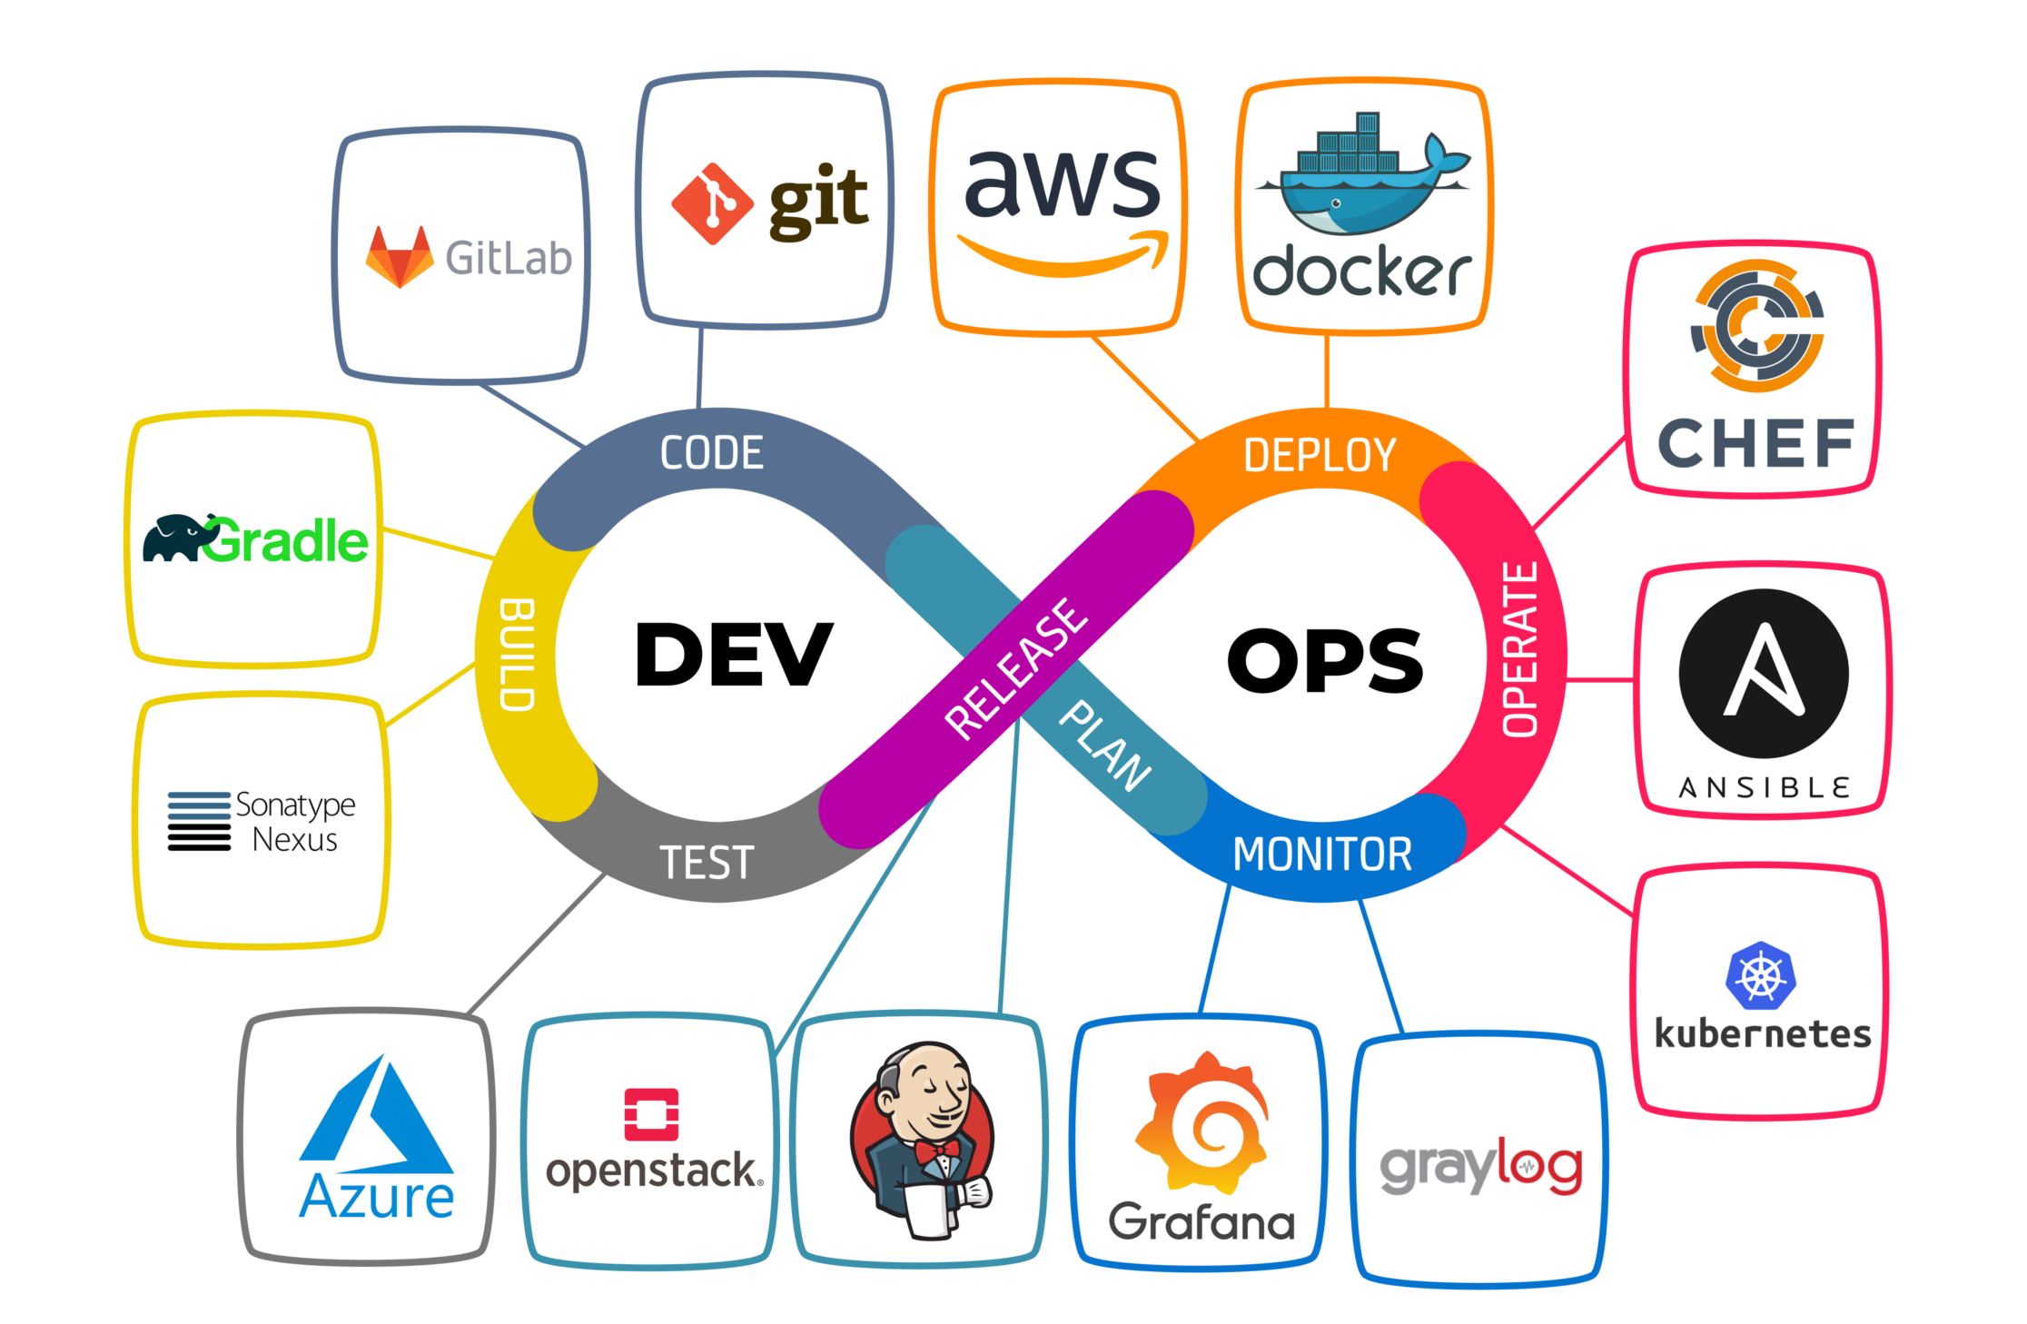
DevOps?
DevOps is what happens when organizations stop treating software development and operations as separate entities and start treating them like complementary functions, working toward the shared goal of better applications

Slide 6
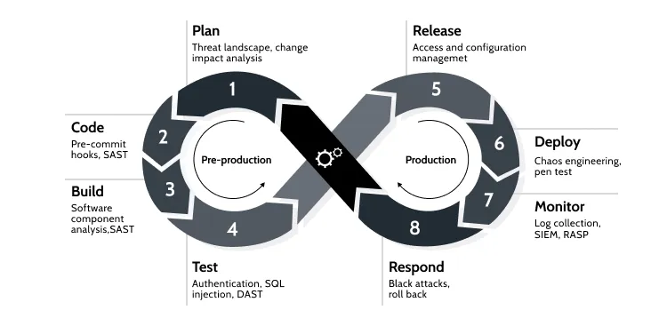
DevSecOps?

Slide 7
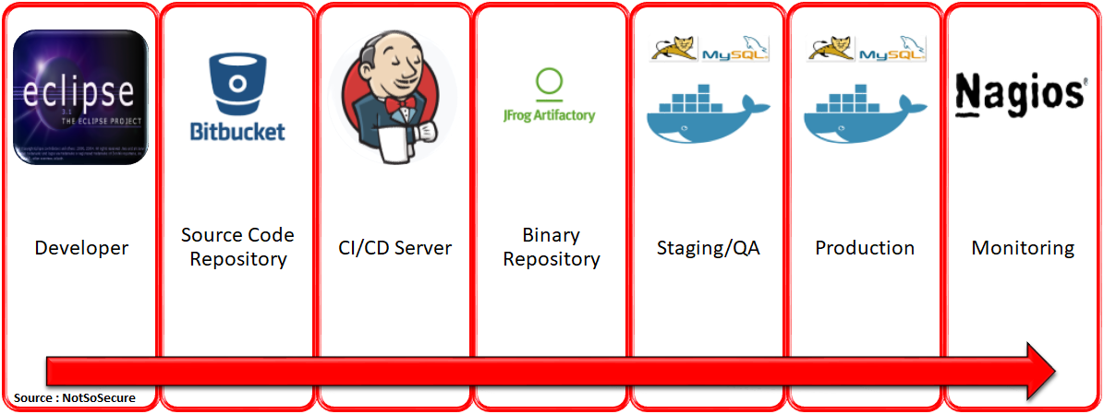
Why DevSecOps?
Example DevOps pipeline:

Slide 8
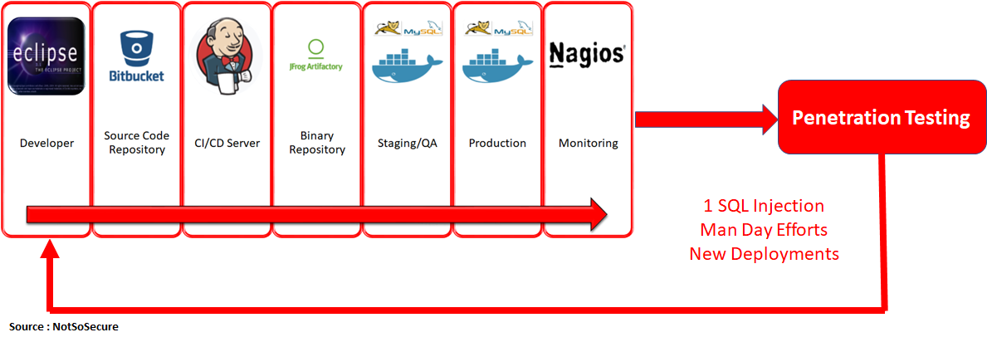
Security Check?

Slide 9
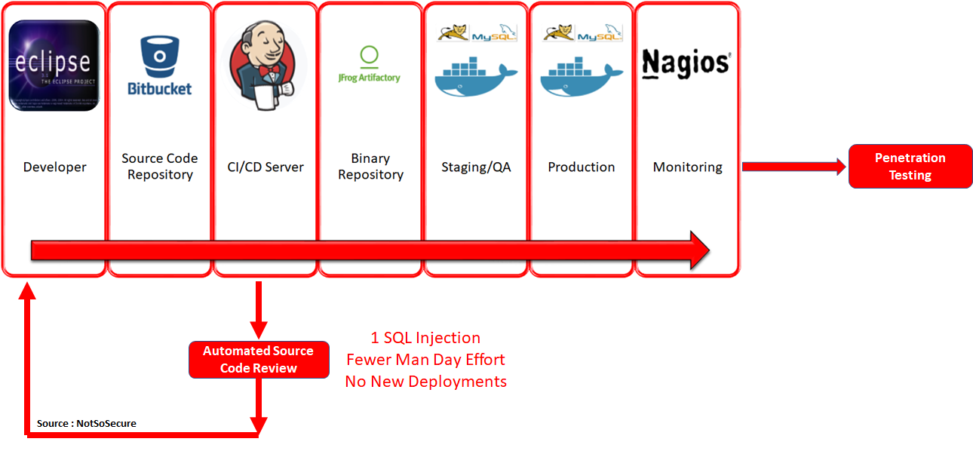
Bring it closer to Dev!

Slide 10
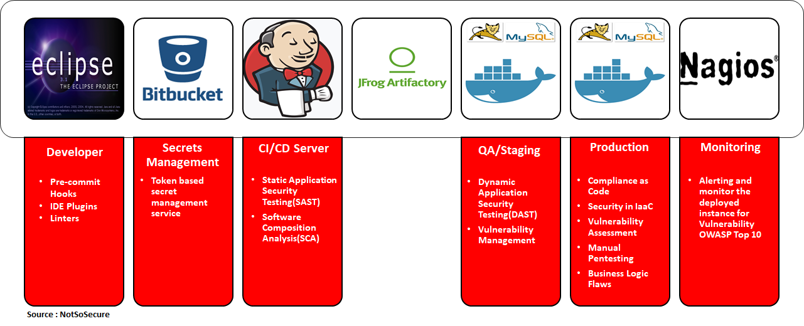
DevSecOps pipeline

Slide 11
Hands-On Part #1: focus on developers
IDE Setup
Git Hooks – Talisman
Secret managements
Software Composition Analysis (SCA): dependency checks
Static Analysis Security Testing (SAST): sonarqube

Slide 12
IDE Setup
SonarLint - Visual Studio Marketplace

Slide 13
Git hooks
thoughtworks/talisman: Using a pre-commit hook, Talisman validates the outgoing changeset for things that look suspicious — such as tokens, passwords, and private keys. (github.com)

Slide 14
Secret management
Vault by HashiCorp (vaultproject.io)

Slide 15
Software Composition Analysis (SCA)
dependency-check-cli – About (jeremylong.github.io)

Slide 16
Static Analysis Security Testing (SAST)
Try out SonarQube (sonarsource.com)
SonarSource Downloads-CDN
C:\Users\achma\sonar-scanner-cli\sonar-scanner-4.8.0.2856-windows\bin\sonar-scanner.bat -D"sonar.host.url=https://sonar.msvc.app" -D"sonar.token=sqp_e835b9179b331646cbff34d5396848a5c233fdf2" -D"sonar.projectKey=training-devsecops-1-expressjs" -D"sonar.qualitygate.wait=true"

Slide 17
Q&A
Questions?

Slide 18
What’s next?
Focus on Ops
DAST – OWASP ZAP
Dockerfile - OPA
Images – Trivy
K8S

Slide 19
Security is Only as Strong as the Weakest Link
for ADINESIA

